Slide 1
Trauma-Informed Care: Perspectives and Resources Electronic Resource Tool
Pediatric/Children’s Disaster Resilience Group Call - March 12, 2015

Slide 2
Presenter
Eileen Elias, MEd
Senior Policy Advisor for Disability and Mental Health
Director, Disability Services Center
JBS International

Slide 3
Webinar Objectives
Provide an overview on trauma resulting from an emergency event on children and youth, families and first responders.
Provide participants with an understanding on how the Trauma Informed Care: Perspectives and Resources Web Based Trauma Tool, through each of its 8 components, provides educational information and value to pediatric emergency providers/responders, researchers, family members, and other key stakeholders.
Provide information on evidence-based & innovative strategies.

Slide 4
Overview on the Impact of an Emergency on Individuals & First Responders: Resulting Trauma

Slide 5
What is a Traumatic Event?
The DSM-IV identifies a traumatic event as one in which the person experiences a threat (actual or perceived) of death or serious injury to self or others, with a response of “intense fear, helplessness or horror.”
It is not the event itself, but the meaning it has for the individual that makes it traumatic.

Slide 6
Impact of Trauma
Health and human service providers are recognizing the pervasiveness of childhood trauma and its negative impact on health outcomes over the lifespan, including elevated risk for depression, suicide, alcoholism, heart disease and other physical and behavioral disorders (CDC, 2014).

Slide 7
Impact of Trauma continued
Despite this knowledge, effective therapeutic and organizational practices that support healing and resilience have not been widely used by leaders who design and administer services and programs.

Slide 8
Trauma Resulting from a Manmade or Environment Based Emergency
Responses, for most people to a manmade or environment based emergency, include fear, anxiety, re-experiencing, urges to avoid, and hyper-arousal symptoms.
Typically, these responses lessen over time.
The individual should be encouraged to use natural supports and to talk with those they are comfortable with – friends, family, co-workers.

Slide 9
Trauma Resulting from a Manmade or Environment Based Emergency Continued
Outcome studies of psychological debriefing do not overall support the use of a one-session, group therapy shortly after the trauma. Some studies found that a single-session may hinder recovery (Bisson, Jenkins, Alexander, & Bannister, 1997; Mayou, Ehlers, & Hobbs, 2000).
Brief interventions are recommended of 3-4 visits over 2-6 weeks time.
Individuals who continue experiencing distress that interferes with functioning after 3 months may be at risk for continued problems and should receive additional treatment.

Slide 10
Trauma & First Responders
First Responders are routinely exposed to traumatic events in the course of their duties.
They are at increased risk for long-term medical and behavioral health problems from traumatic stress, including being vulnerable to PTSD.
This is significant for First Responders, who are constantly exposed to traumatic events.

Slide 11
Understanding & Using the “Trauma Informed Care: Perspectives and Resources” Tool

Slide 12
Orientation to the 8 Modules in the “Trauma Informed Care: Perspectives and Resources” Tool
Each module contains:
Introductory Video
Video compilations of policy makers, direct care staff, program developers and experts
Issue Brief
Resources

Slide 13
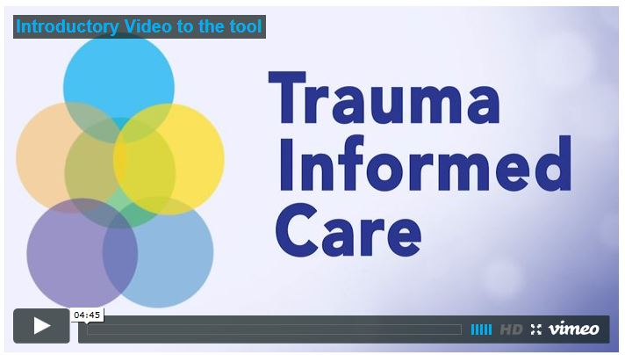
Trauma-Informed Care: Perspectives and Resources
A comprehensive web-based, video-enhanced tool
http://gucchdtacenter.georgetown.edu/TraumaInformedCare/
http://trauma.jbsinternational.com/traumatool/

Slide 14
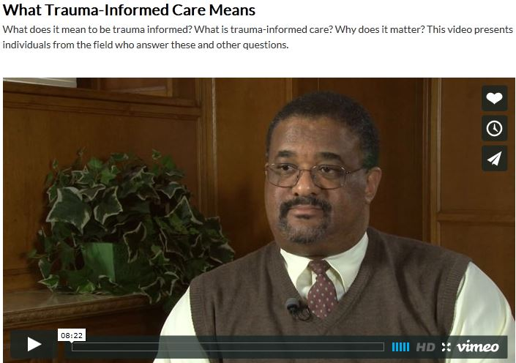
Trauma-Informed Care
What does this mean on how we provide care?
What Trauma-Informed Care Means Videohttps://vimeo.com/99762513

Slide 15
Adverse Childhood Experience (ACE) Study
One of the largest investigations ever conducted to assess associations between childhood maltreatment and later-life health and well-being.
Collaboration between the Centers for Disease Control and Prevention and Kaiser Permanente's Health Appraisal Clinic in San Diego.

Slide 16
ACE Study Continued
Initial phase: 1995 to 1998
More than 17,000 participants
Completed a standardized physical examination and a confidential survey that contained questions about childhood maltreatment and family dysfunction, as well as items detailing their current health and status behaviors.
No further participants were enrolled, but medical status of baseline participants tracked over time.

Slide 17
Adverse Childhood Experiences Studied
Childhood Abuse
Emotional
Physical
Sexual
Neglect
Emotional
Physical
Household Situations:
Parental separation or divorce
Household substance abuse
Mother treated violently
Incarcerated household member

Slide 18
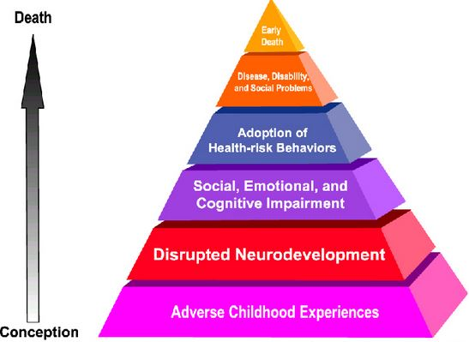
ADVERSE CHILDHOOD EXPERIENCES
http://www.cdc.gov/violenceprevention/acestudy/

Slide 19
ACE Score & Link with Suicide Attempts

Slide 20
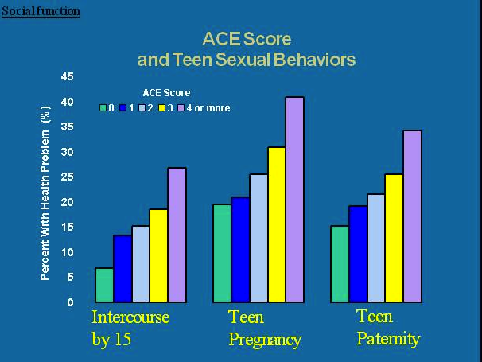
ACE Score and Teen Sexual Behaviors

Slide 21
Henry’s Story - https://vimeo.com/103538479

Slide 22
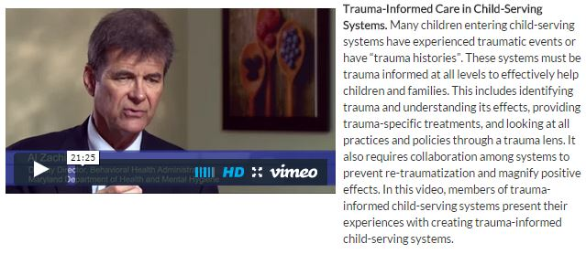
Trauma-Informed Care in Child-Serving Systems - https://vimeo.com/105283964

Slide 23
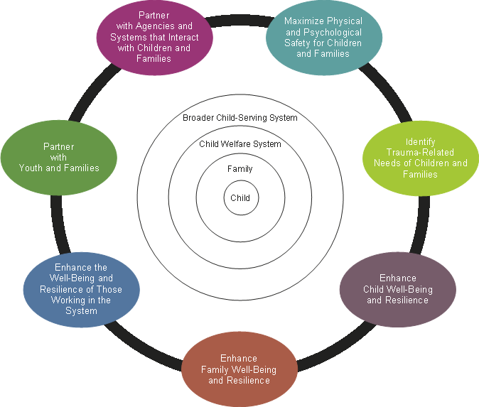
Essential Elements of a Trauma-Informed Child Welfare System

Slide 24
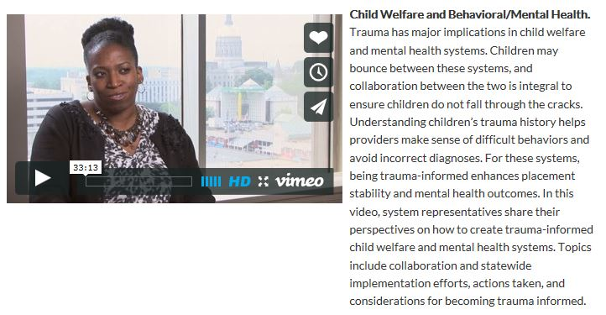
Child Welfare and Behavioral/Mental Health https://vimeo.com/105580555

Slide 25
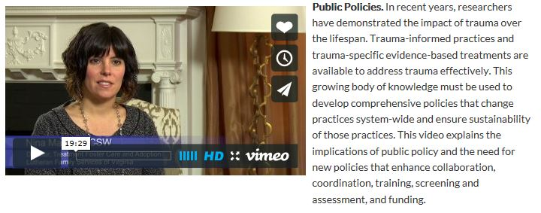
Public Policies https://vimeo.com/105155964

Slide 26
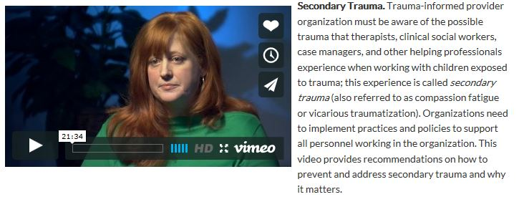
Secondary Trauma https://vimeo.com/100922533

Slide 27
Strategies to Address Secondary Trauma
Personal strategies, such as respecting one's own limits and maintaining time for self-care activities.
Professional strategies, such as balancing caseload, having supervision and support available.
Organizational strategies, such as sufficient time off and safe physical space.

Slide 28
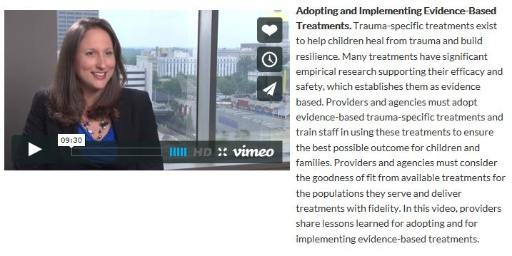
Adopting & Implementing Treatments – Module 4 Video https://vimeo.com/100531287

Slide 29
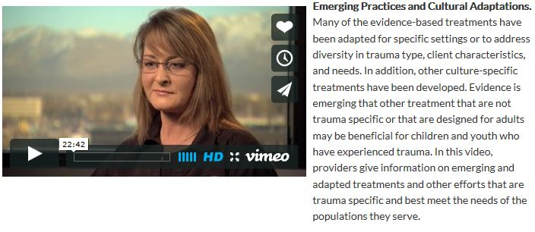
Cultural Adaptations https://vimeo.com/106203076

Slide 30
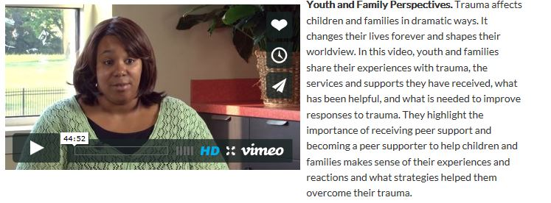
Youth & Family Perspective https://vimeo.com/105717042

Slide 31
What is the Cost of Trauma?
Extremely difficult to approximate because typical surveillance does not track trauma
Must look to specific conditions/diagnoses
For example, the cost of child maltreatment in 2010 was $124 billion dollars, $210,012 per child (Fang et al, 2012)
How does that break down?
System | Cost
Child Health Care | $32,648
Adult Health Care | $10,530
Productivity Loss | $144,360
Child Welfare | $7,728
Criminal Justice | $6,747
Special Education | $7,999

Slide 32
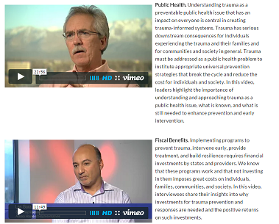
Public Health Approach & Fiscal Benefits https://vimeo.com/106501004 - Public Health https://vimeo.com/106420574 - Fiscal Benefits

Slide 33
What's Next? The New Frontier for Research & Practice in Trauma-Informed Care
Understanding the impact of trauma on epigenetic changes.
Identifying and addressing the needs specific populations, including military families, survivors of sex trafficking, and incarcerated mothers with untreated childhood trauma exposure.
Developing gender-specific practices and treatments.
Researching about which treatment approaches are most effective for specific populations, including those involved in an emergency situation.
Partnering with juvenile courts, law enforcement, and first responders in implementing trauma-informed approaches.

Slide 34
What's Next? The New Frontier for Research & Practice in Trauma-Informed Care Continued
Primary prevention programs to decrease preventable trauma exposures
Self-care approaches for helping professionals, including emergency responders avoid secondary traumatic stress
Financial impact of not addressing trauma and the cost-benefits of trauma-informed care
Reexamining prescribing patterns of psychotropic medication

Slide 35
Contact Information
Eileen Elias, MEd
JBS International
5515 Security Lane
Suite 800
North Bethesda, MD 20852
Office Phone: 240 645 4534
eelias@jbsinternational.com

